Slide 1
A Workshop
On
Geospatial Artificial Intelligence for Climate Change Mitigation.
By
Serah Akojenu and Rashidat Sikiru
Date: 6th June, 2024
Enabling 1 Million Artificial Intelligence talents in Africa

Slide 2




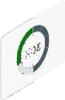


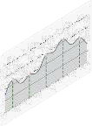

Outline
Overview of Climate change
Overview of geospatial science and its data types
Geospatial AI and its relevance
Application of GeoAI
Hands-On Session.

Slide 3
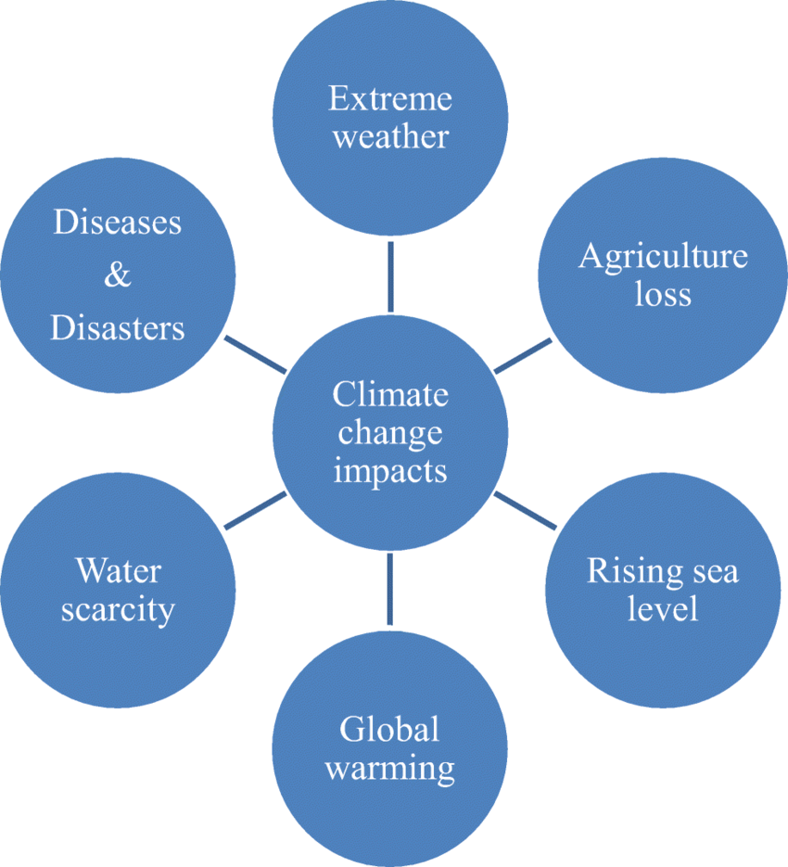
What is Climate Change?
Climate change is a long-term alteration in weather patterns caused by natural processes and human activities, affecting the global atmosphere and affecting the planet's climate. Mitigation is crucial due to its potentially irreversible effects on the environment, human health, and global economies.
Source: Research Gate

Slide 4
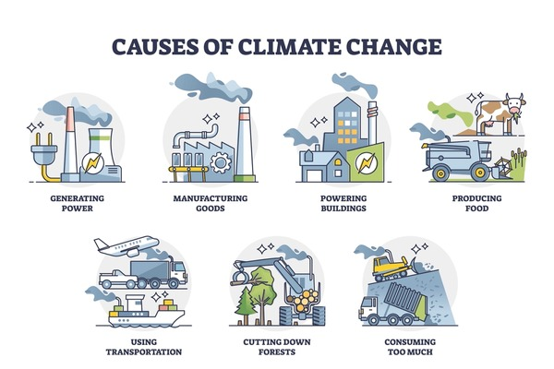
Causes of Climate Change
Climate change is driven by both human activities and natural processes. Here is a summary of the primary causes:
Anthropogenic (Human-Induced) Causes
Fossil Fuel Combustion
Deforestation
Industrial Processes
Agriculture
Waste Management.
Natural Causes
Volcanic Activity
Solar Variability
Natural Climate Cycles
Source: https://www.shutterstock.com/search/causes-climate-change?image_type=vector

Slide 5
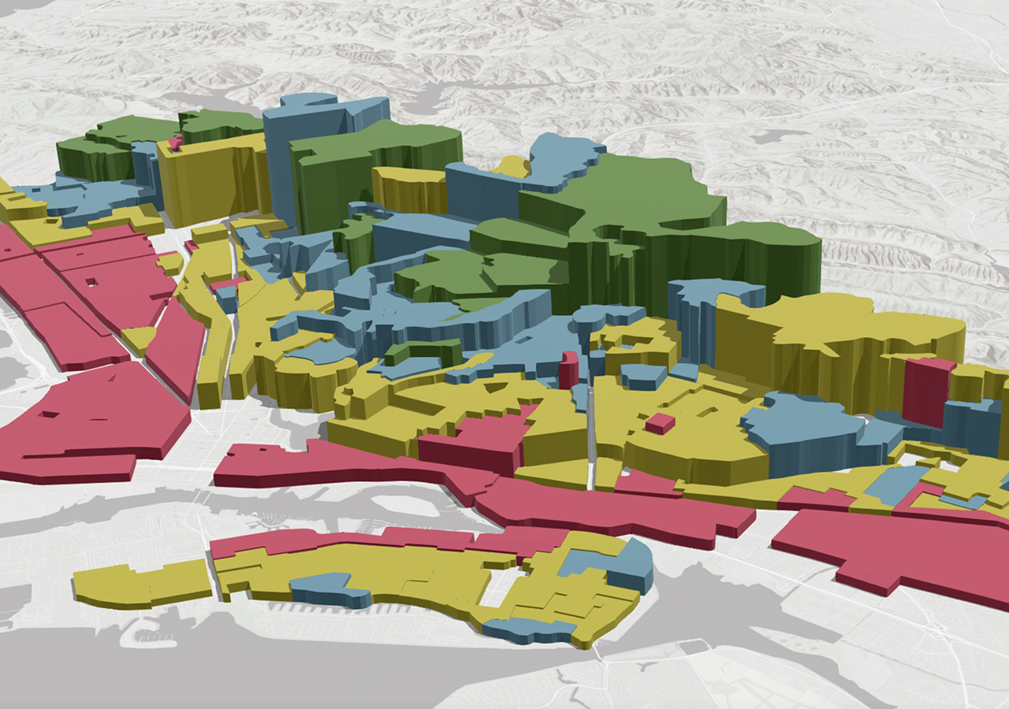
GEOGRAPHIC INFROMATION SYSTEM
GIS is a system that creates, manages, analyzes, and maps all types of data.
It connects data to a map, integrating location data (where things are) with all types of descriptive information (what things are like there)
GIS helps users understand patterns, relationships, and geographic context.

Slide 6
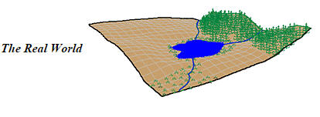
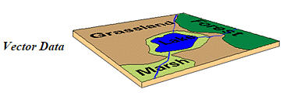
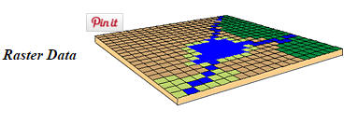
Geospatial And Geospatial Data
Geospatial data is information that describes objects, events or other features with a location on or near the surface of the earth.
Types of Geospatial Data
The two main types of geospatial data are
Vector data: lines, point and polygon(e.g. Administrative boundaries )
Raster data: rows and columns matrix (e.g. Satellite Images)

Slide 7

Geospatial AI Use Cases
Infrastructure Development
Disaster Management
Climate Change Analysis
Crop Monitoring.
Source: https://integralgis.com/capabilities/geographic-information-systems-gis/

Slide 8
Geospatial AI Use Cases
Infrastructure Development
GeoAI helps in planning and optimizing urban infrastructure, including transportation networks, utilities, and public services by analyzing population density, traffic patterns, and land use.
Disaster Management
Predicting and managing the impact of natural disasters such as floods, earthquakes, and hurricanes by analyzing spatial data to improve response strategies and resource allocation.
Climate Change Analysis
GeoAI is used to track and predict the impacts of climate change by analyzing patterns in temperature, precipitation, and sea-level rise using satellite imagery and remote sensing data.
Satellite and drone imagery analyzed by AI can monitor crop health, detect diseases, and predict yields, allowing for timely interventions.
Crop Monitoring
Mapping the spread of diseases and identifying hotspots to plan effective interventions and allocate healthcare resources efficiently.
Disease Tracking

Slide 9

Case Study Demostration
Exploring Temperature, and Precipitation Using GeoAI
Objective
To analyze temperature, and precipitation patterns using Geospatial Artificial Intelligence
Data Sources
Satellite Imagery: Using data from satellites such as Chirps and TerraClimate data.
Tools and Libraries
Google Earth Engine (GEE): For processing large-scale geospatial data.
Python Libraries: Pandas, NumPy, Matplotlib

Slide 10








Data Scientists Network Foundation
Website: www.datasciencenigeria.org
Twitter: dsn_ai_network
Instagram: dsn_ai_network
Facebook: facebook.com/dsnailive
YouTube: https://goo.gl/Vcjjyp
Linkedin: https:linkedin.com/company/dsnai/
Annual Report: https://bit.ly/DSNAnnualreport-2021-2022

